Slide 1
Grocery Consumer Analysis.
Yen Huynh

Slide 2
Relevant Dataset Features
Year_Birth: Customer's birth year
Education: Customer's education level
Marital_Status: Customer's marital status
Income: Customer's yearly household income
Kidhome: Number of children in customer's household
MntMeatProducts: Amount spent on meat in last 2 years
MntWines: Amount spent on wine in last 2 years
Recency: Number of days since customer's last purchase
Complain: 1 if the customer complained in the last 2 years, 0 otherwise
Response: 1 if customer accepted the offer in the last campaign, 0 otherwise Place

Slide 3
How well are the company doing ?
How satisfying consumers are with our service and products?
1
How much of a customer’s background affect their number of purchases?
2
How effective the Marketing Campaign are with their promotions?
3

Slide 4
1. How satisfying consumers are with our service and products?
- Some customers complained about products that they bought.
- Some never made a complain.
Do their background have any affect on how satisfying they are with our products?
- Method used: Logistic Regression

Slide 5
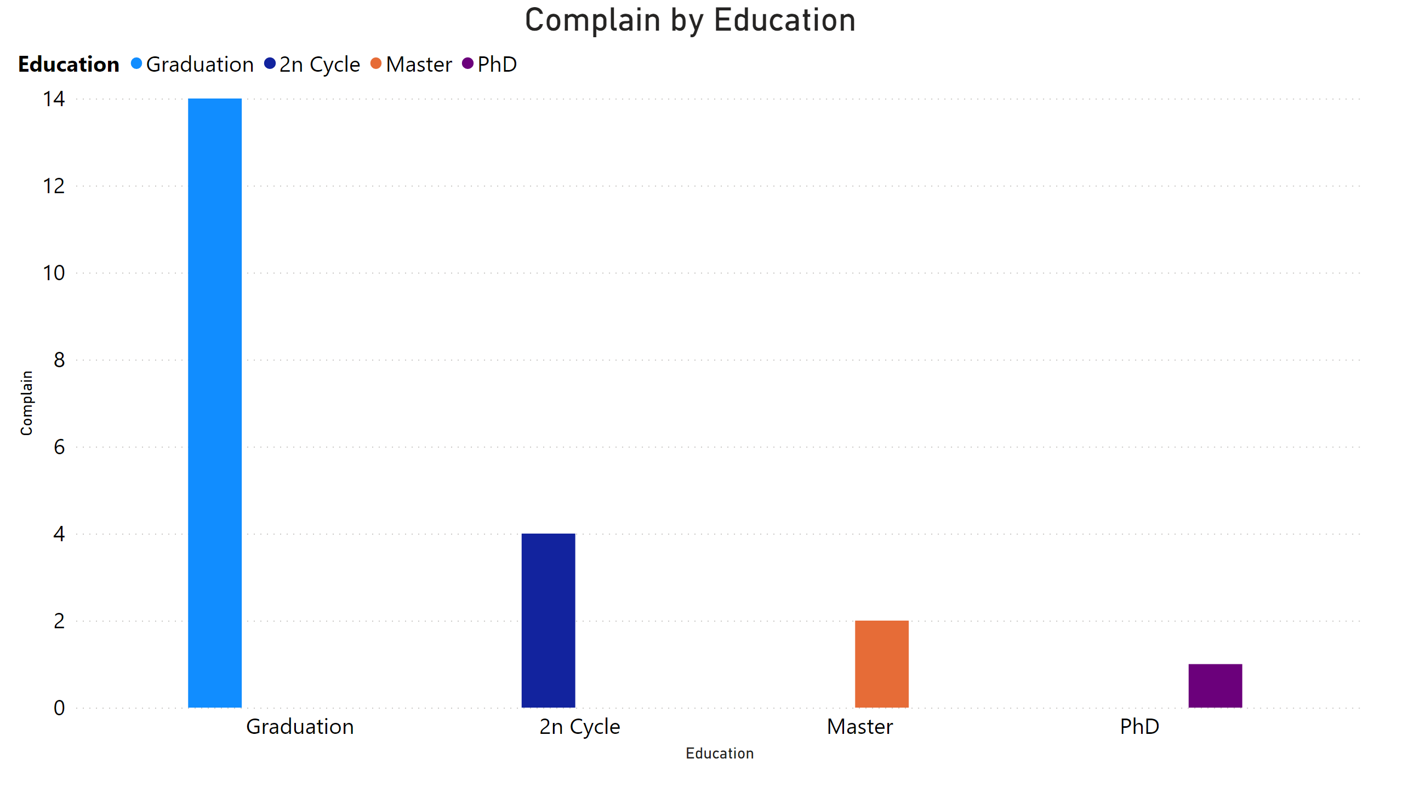
- Education is one of the significant element contributing into customer’s satisfaction.

Slide 6
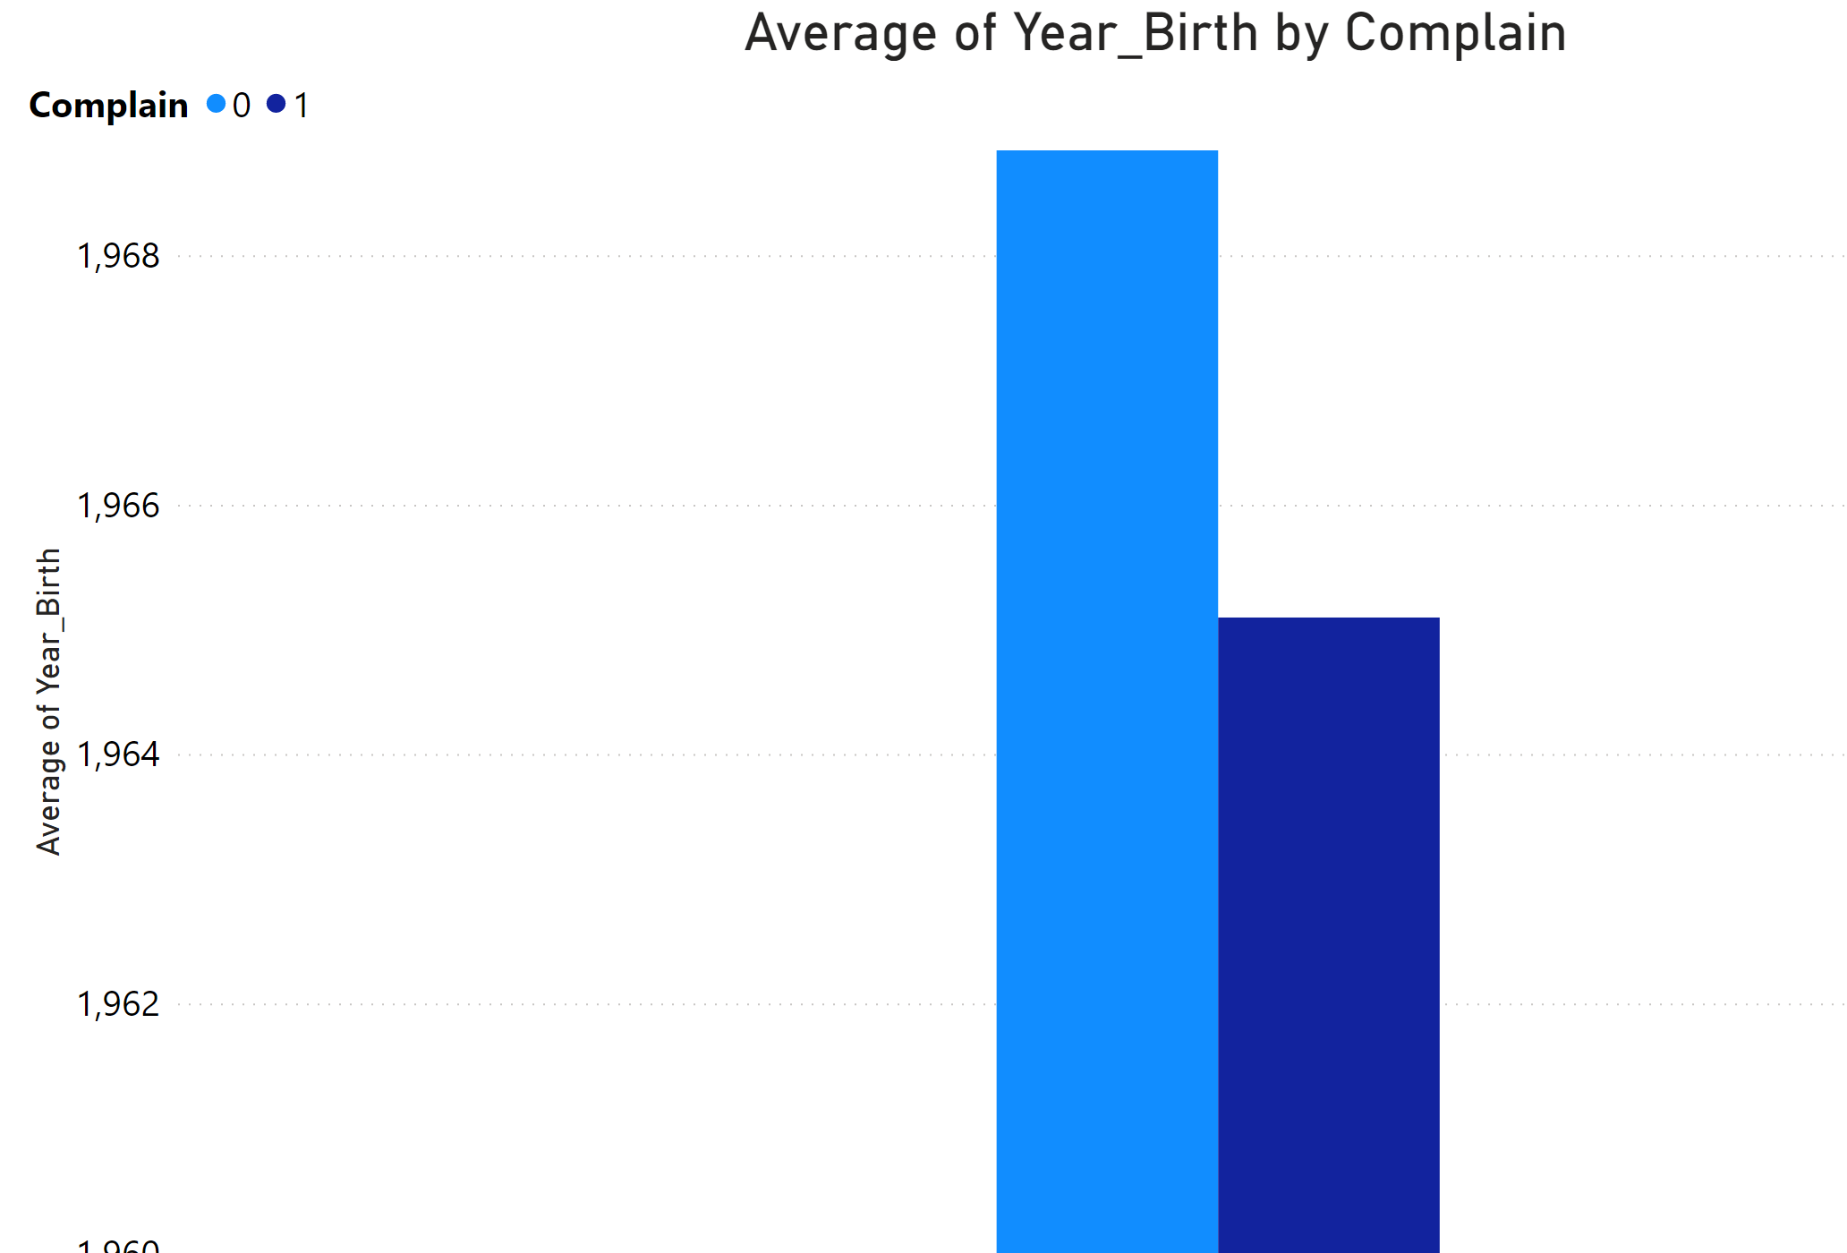
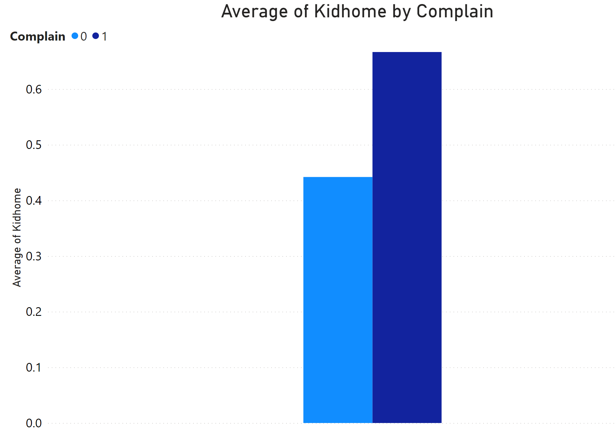
- Year of birth is also a significant element to contributing into customer’s satisfaction. ( older people had made more complains) - Number of kids might contribute into customer’s satisfaction.

Slide 7
Conclusion:
We can predict the probability of complain from customers from Logistic Regression model.
Ex: Customer who was born in 1964, graduation degree, married, earning 200K/year, having 8 kids. Number of days since customer's last purchase is 40.
65% the probability consumer being unsatisfied

Slide 8
2. How much of a customer’s background affect their number of purchases?
Examine the relationship between customer's year-birth, income, numbers of kids and total number of purchases.
Which group of buyer would make more frequent purchases?
- Method used: K-means clustering.

Slide 9
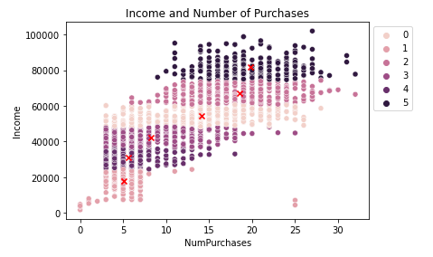
Income and Number of purchases form a pattern in clustering. - Average number of purchases, average and low income. - High number of purchases, high income.

Slide 10
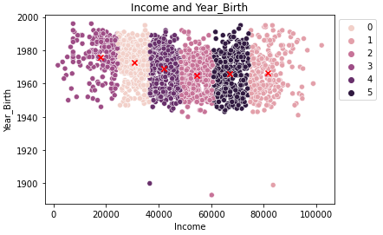
Year of birth can predict the pattern of consumer’s income. - Born 1960s, higher income ($50K - $80K). - Born 1970s, lower income ($18K - $42K).

Slide 11
Conclusion
High-income customers are more likely to spend on products.
Customers who born in 1960s might have better income since they’re older.
Ex: A new customer with NumPurchases = 32, Income=$75K, and Year_Birth = 1965.
Belongs to cluster 1: make frequent purchases.

Slide 12
3. How effective the Marketing Campaign are with their promotions?
Marketing team has promoted 5 times over the last 2 years.
Which customer would be likely to respond to marketing promotion?
- Method used: Naive Bayes technique.

Slide 13
Factors affect if consumers would respond to promotion.
Gaussian Naïve Bayes/Bernoulli's Naïve Bayes model correlation:
Categories correlate with “Respond” category:
- Income (0.12)
- Amount of spending on wines, meats (0.2)
- Number of catalog purchases (0.2)

Slide 14
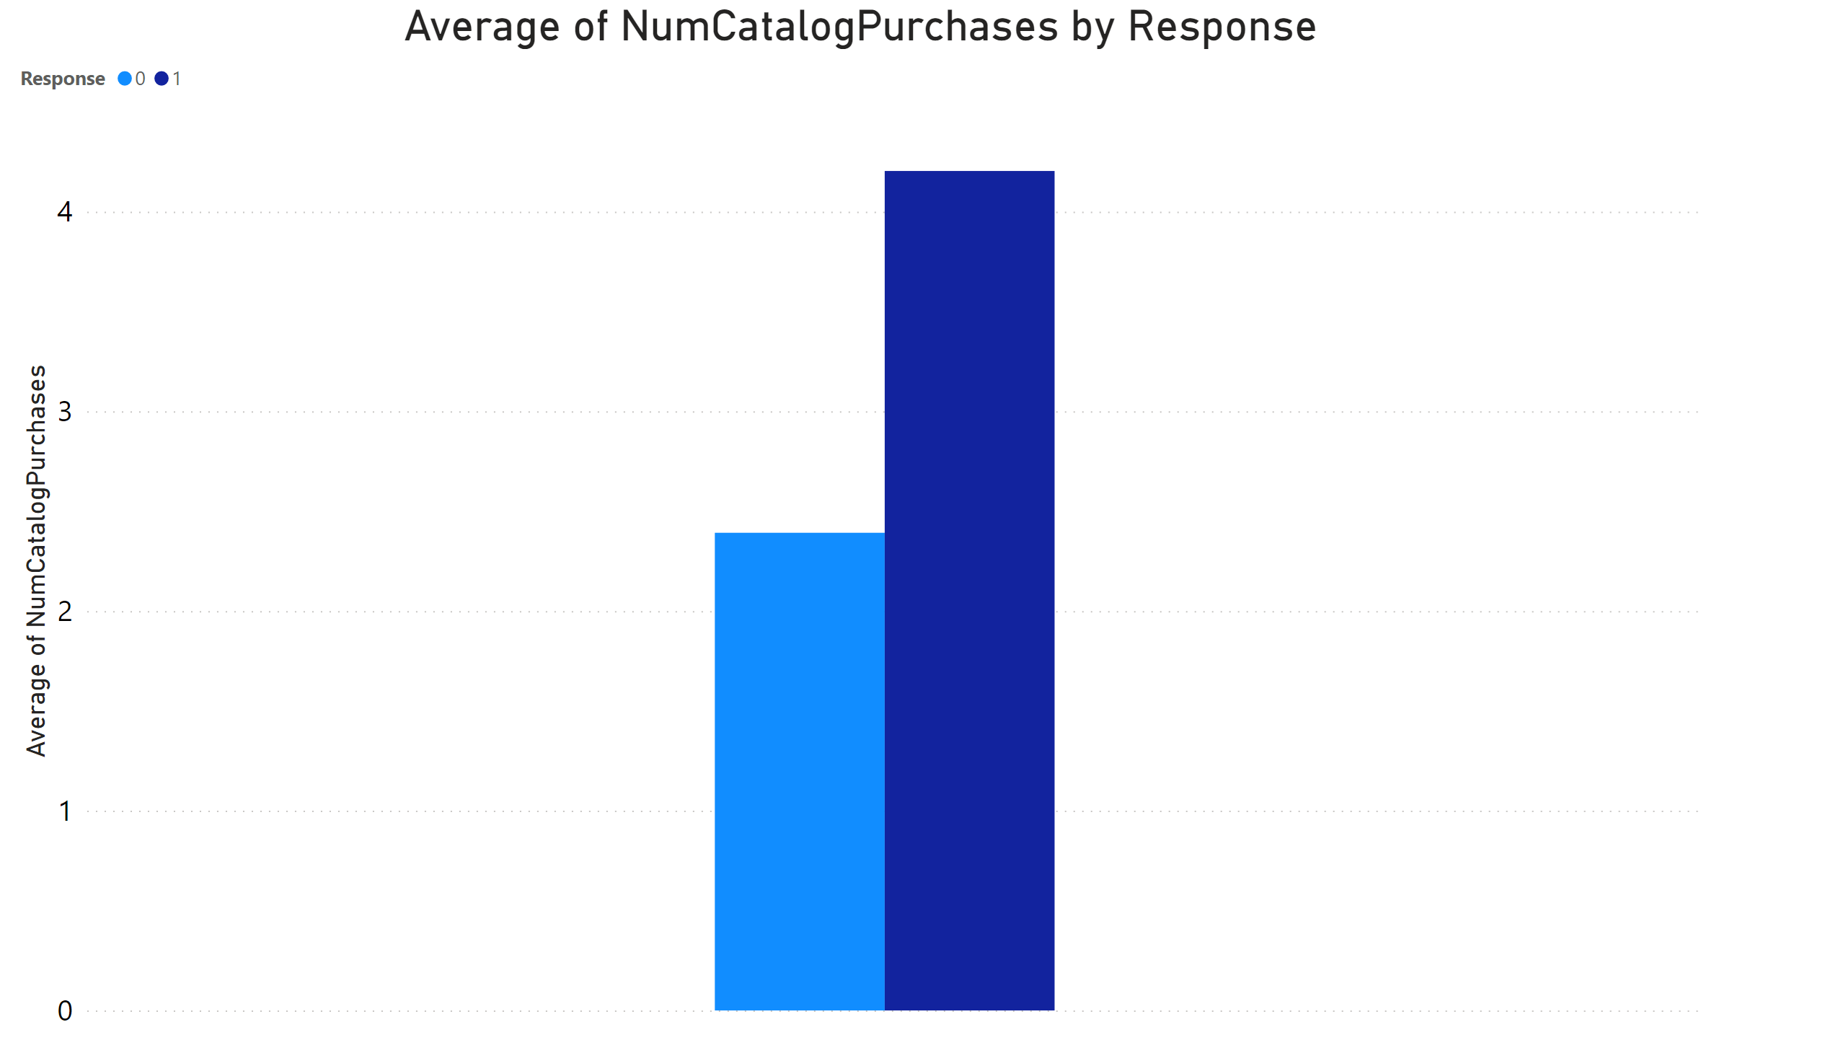
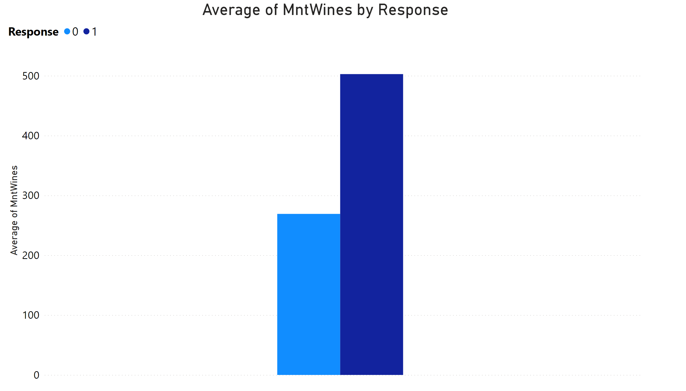
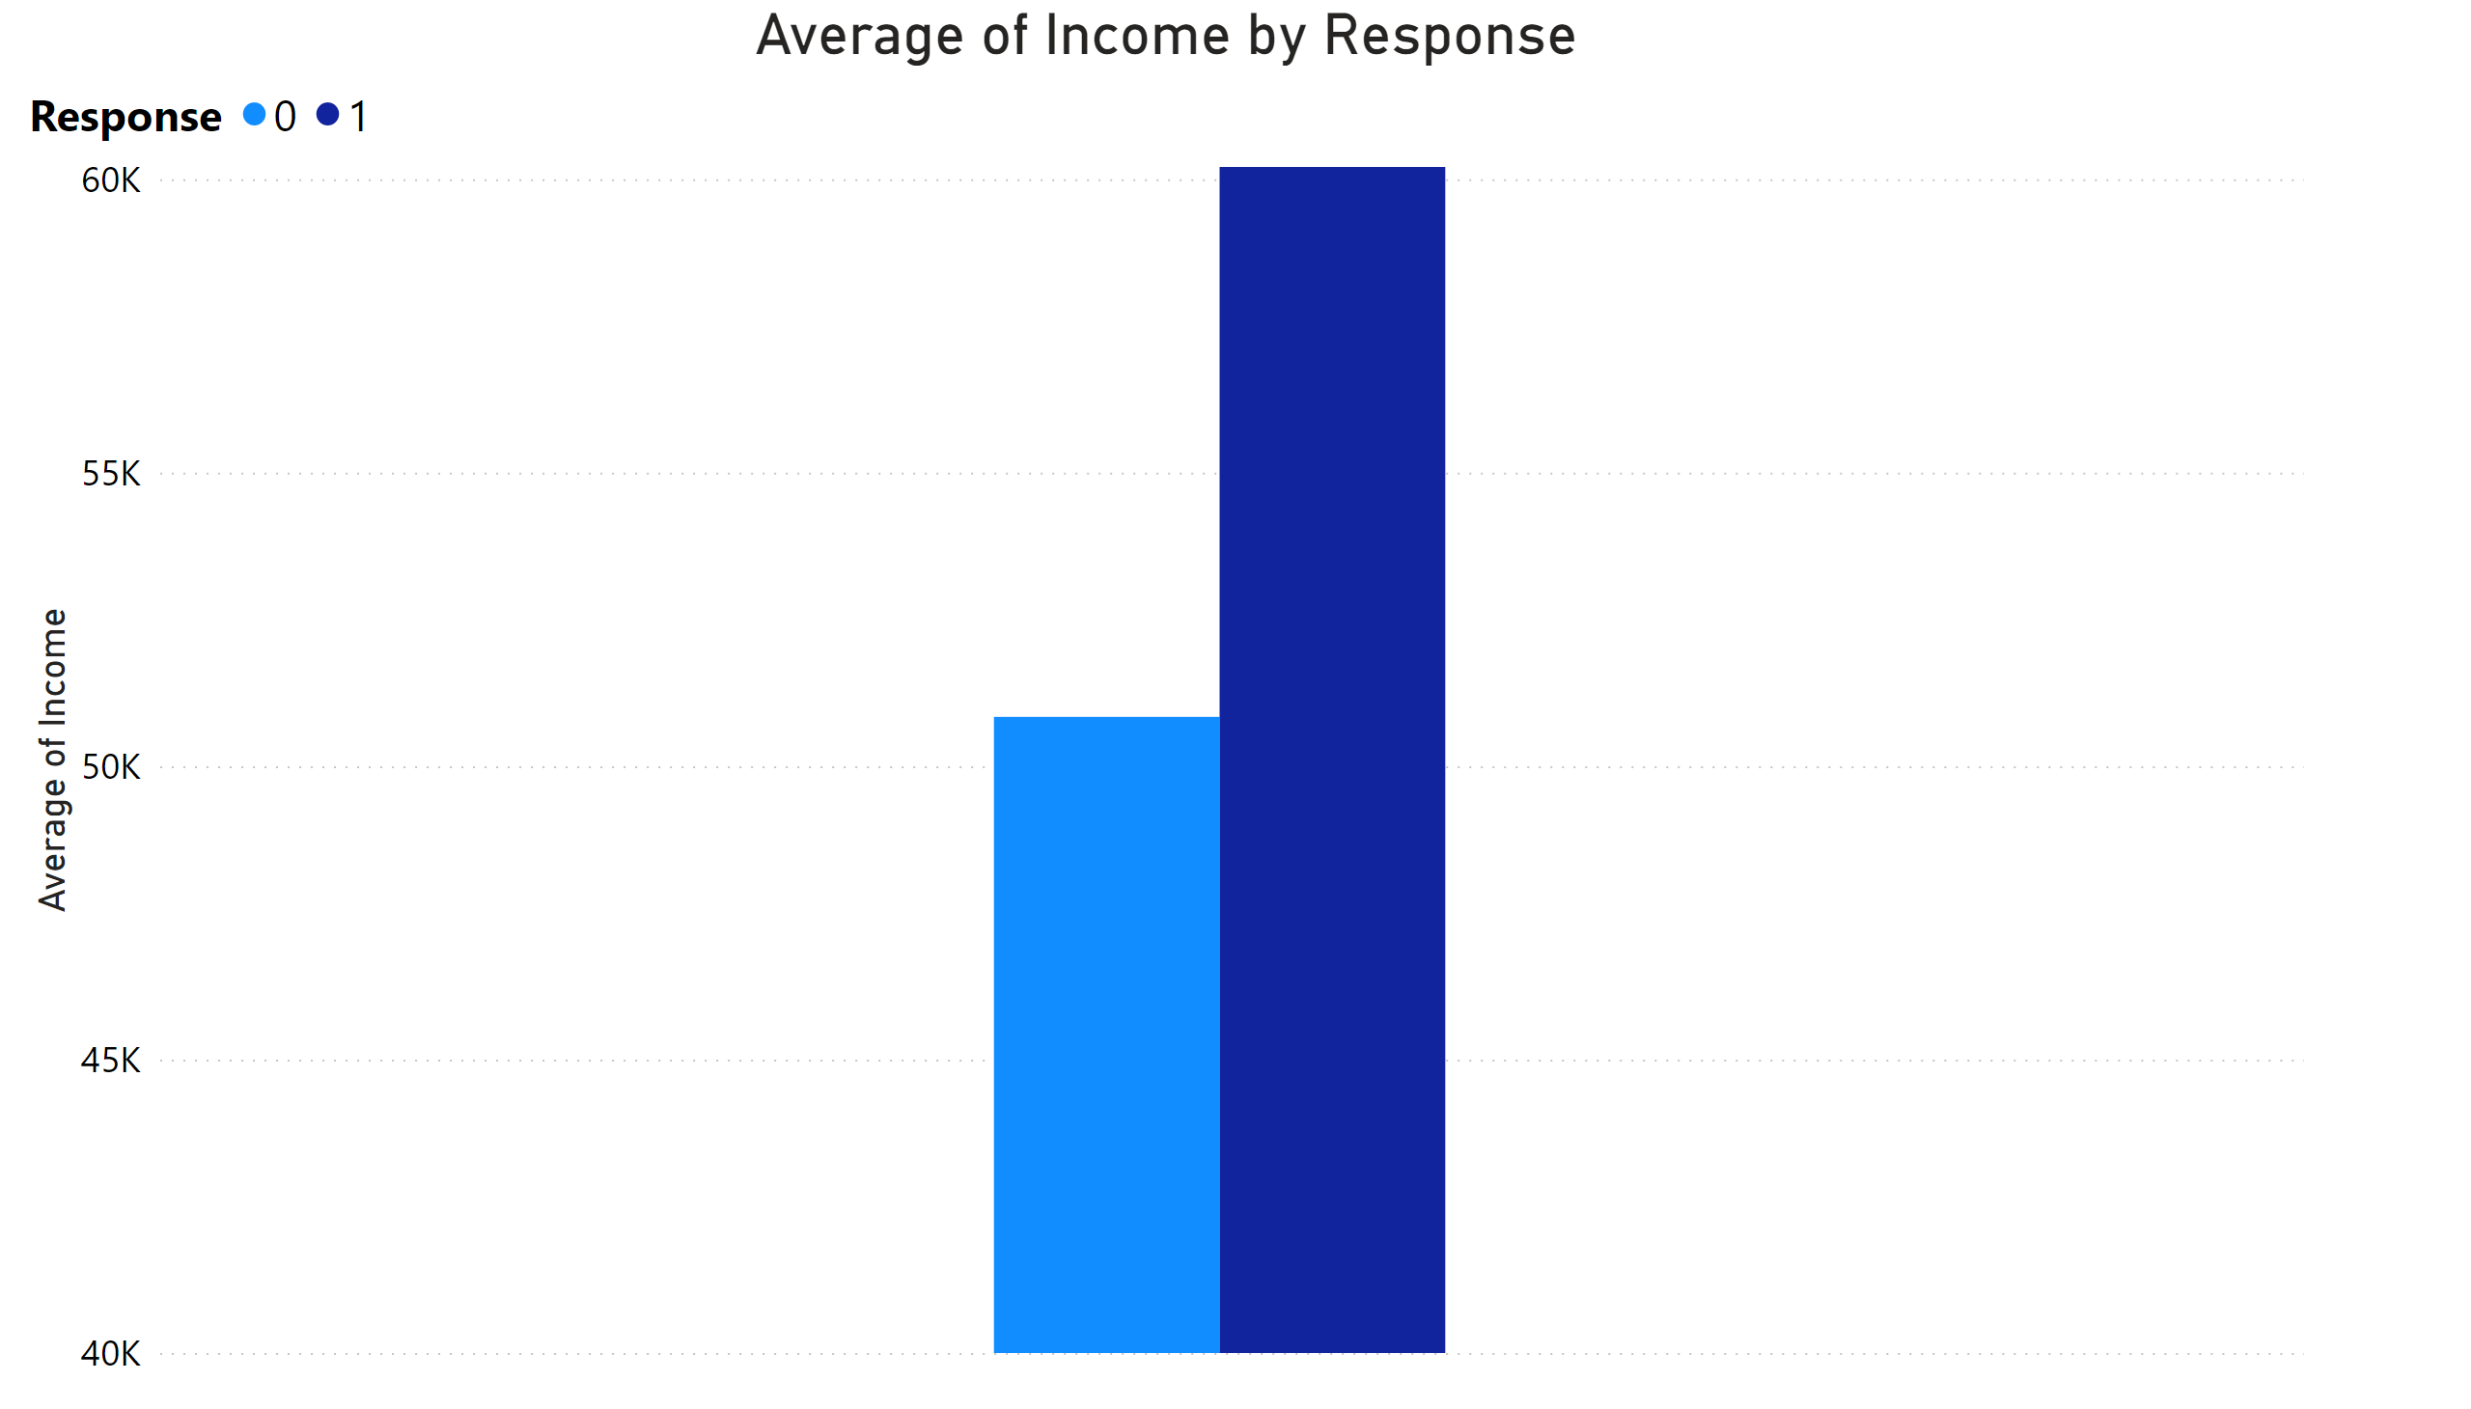
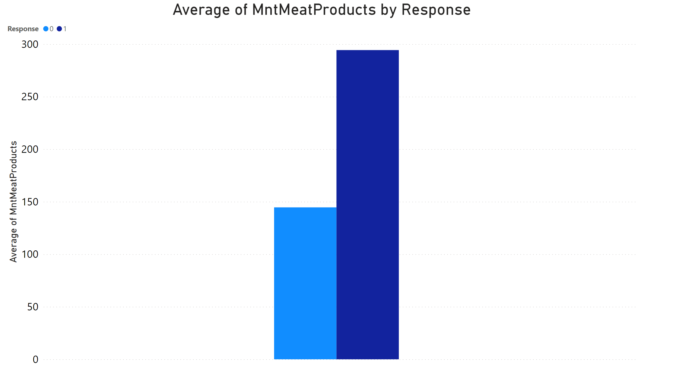

Slide 15
Wrap up:
Education, year of birth, and number of kids consumers having might affect on the level of customer’s satisfaction upon purchasing.
- Customer’s income might decide their number of purchasing.
Customer’s income could be predicted based on their birth year.
Customers would be likely to take advantage of promotion if they have high income (>60K), are wine and meat spenders, catalog users.

